Slide 1
MY TEAM MEMBERS: SHRI KASHIKA M
SAMEETHA J SHERINA MERLINE X
SIVASRI D

Slide 2



HEALTH MONITORING APPLICATION & DEVICES

Slide 3
WEEK 1 ACTIVITY BRAIN-STORMING

Slide 4
KEYWORDS
HEART RATE
BLOOD PRESSURE
GLUCOSE LEVEL
SLEEP TRACKING
FITNESS TRACKING
OXYGEN SATURATION
ELECTROCARDIOGRAM
CALORIE BURN
STRESS LEVEL
BODY TEMPERATURE
HYDRATION MONITORING
RESPIRATORY RATE
STEP COUNT
ACTIVITY TRACKING
FALL DETECTION
SKIN TEMPERATURE
UV EXPOSURE
MEDICATION REMINDERS
HEALTH DATA ANALYSIS
SMART WEARABLE
REMOTE MONITORING
CHRONIC DISEASE MANAGEMENT
PERSONAL HEALTH RECORDS
BIO FEEDBACK

Slide 5








SORTING AND AFFINITY LINK
VITAL MONITORING
HEART RATE BLOOD PRESSURE
OXYGEN SATURATION BODY TEMPERATURE
RESPIRATORY RATE SKIN TEMPERATURE
DISEASE & HEALTH MANAGEMENT
GLUCOSE LEVEL MEDICATION REMINDERS STRESS LEVEL
FALL DETECTION
ELECTROCARDIOGRAM
CHRONIC DISEASE MANAGEMENT
FITNESS TRACKING
SLEEP TRACKING UV EXPOSURE FITNESS TRACKING CALORIE BURN STEP COUNT ACTIVITY TRACKING
HEALTH DATA & ANALYSIS
HYDRATION MONITORING SMART WEARABLE
BIO FEEDBACK
HEALTH DATA ANALYSIS REMOTE MONITORING PERSONAL HEALTH RECORDS

Slide 6
WEEK 2 ACTIVITY MIND -MAPPING

Slide 7






VITAL MONITORING
HEART RATE BLOOD PRESSURE
OXYGEN SATURATION BODY TEMPERATURE
RESPIRATORY RATE SKIN TEMPERATURE
HEALTH DATA & ANALYSIS
HYDRATION MONITORING SMART WEARABLE
BIO FEEDBACK
HEALTH DATA ANALYSIS REMOTE MONITORING PERSONAL HEALTH RECORDS
HEALTH MONITORING APPLICATION & DEVICES
FITNESS TRACKING
SLEEP TRACKING UV EXPOSURE FITNESS TRACKING CALORIE BURN STEP COUNT ACTIVITY TRACKING
DISEASE & HEALTH MANAGEMENT
GLUCOSE LEVEL MEDICATION REMINDERS STRESS LEVEL
FALL DETECTION
ELECTROCARDIOGRAM
CHRONIC DISEASE MANAGEMENT

Slide 8
WEEK 3 ACTIVITY MATRIX TABLE

Slide 9
TABLE OF CONTENTS
DISEASE AND HEALTH MANAGEMENT
VITAL MONITORING
FITNESS TRACKING
HEALTH DATA & ANALYSIS
MONITORING OF VITAL SIGNS LIKE HEART RATE,BP ETC...
MANAGING DISEASES AND OVERALL HEALTH CONDITIONS
TRACKING PHYSICAL ACTIVITIES AND FITNESS TRACKING
ANALYZING HEALTH RELATED DATA FOR INSIGHTS
WHAT?
PATIENTS,HEALTHCARE PROVIDERS,CAREGIVERS
PATIENTS,DOCTORS, HEALTHCARE PROFESSIONALS
INDIVIDUALS,FITNESS ENTHUSIASTS, TRAINERS
DATA ANALYSTS,HEALTHCARE PROFESSIONALS
WHO?
HOSPITALS,CLINICS, ONLINE PLATFORMS
GYMS,HOMES, OUTDOORS
HEALTHCARE FACILITIES,RESEARCH CENTERS
WHERE?
HOSPITALS,CLINICS, SETTINGS
CONTINOUSLY,PERIODICALLY
DURING TREATMENT,AS NEEDED
WHEN?
DAILY OR WEEKLY
AFTER DATA COLLECTION
TO ENSURE CRITICAL HEALTH PARAMETERS ARE STABLE
TO CONTROL,PREVENT AND MANAGE HEALTH ISSUES
TO MAINTAIN AND IMPROVE FITNESS AND HEALTH
TO GAIN INSIGHTS,IMPROVE TREATMENTS AND PREDICT
WHY?
USING WEARABLE DEVICES,MONITORS,APPS
THROUGH MEDICATION,THERAPIES AND MONITORING
USING FITNESS TRAKERS,APPS AND WEARABLES
UTILIZING SOFTWARE,AI AND DATA ANALYTICS
HOW?

Slide 10
WEEK 4 ACTIVITY USER PARTICIPANT MAPPING

Slide 11
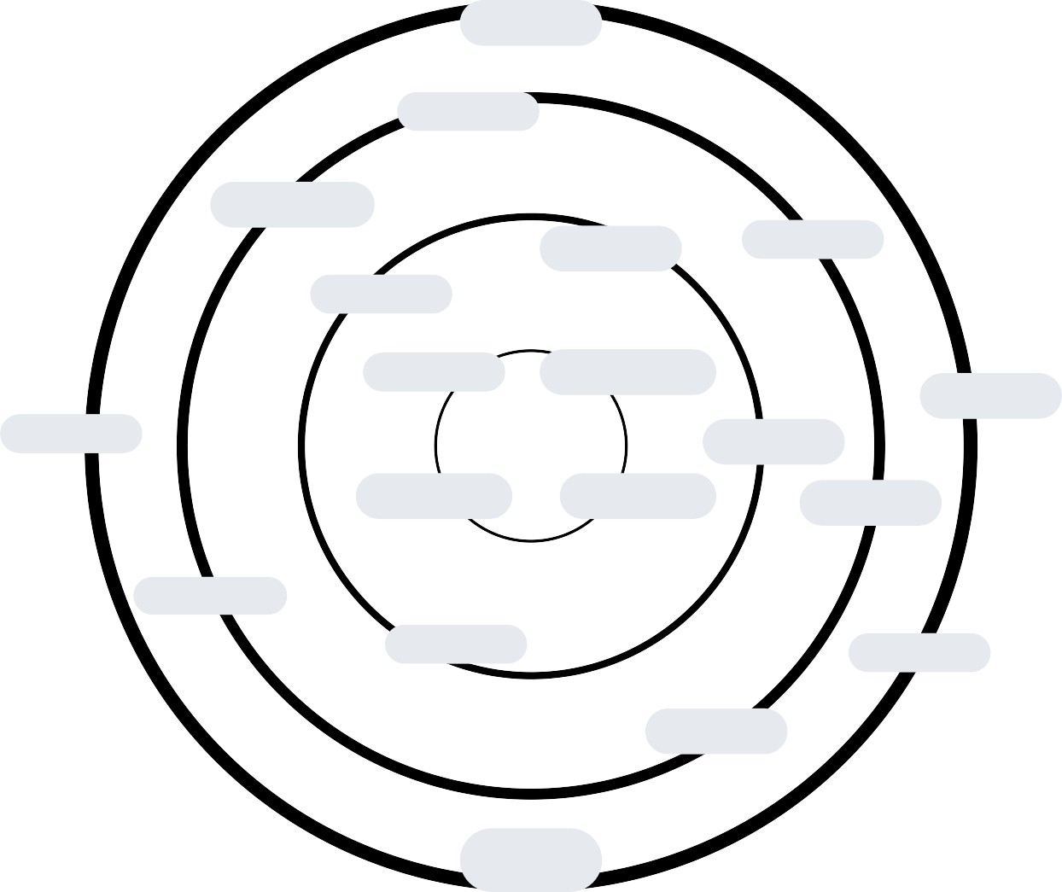




PUBLIC HEALTH AUTHORITIES
DATA ANALYST
TELECOMMUNICATION COMPANIES
HEALTH INSURANCE COMPANIES
AI RESEARCHERS
FITNESS TRAINERS
PATIENTS
HEALTH CARE PROVIDERS
TECHNOLOGY VENDORS
ADVOCACY GROUPS
HEALTH MONITORING APPLICATION & DEVICES
PHARMACEUTICAL COMPANIES
HEALTH MONITORING DEVICES
EMERGENCY SERVICES
RESEARCH INSTITUTES
APP DEVELOPERS
FAMILY MEMBERS
MEDIA
REGULATORY AUTHORITIES
COMMUNITY HEALTH ORGANIZERS

Slide 12
WEEK 5 ACTIVITY CONTEXTUAL INQUIRY

Slide 13
DEMOGRAPHICS
12
10
8
AGE DISTRIBUTION
NO OF USERS
6
GENDER DISTRIBUTION
4
30
25
20
15
10
5
2
0
18-25
26-35
36-45
46-55
56+
0
MALE
FEMALE

Slide 14













WEARABLE DEVICE
MEDICAL DEVICE
SENSORS
BLUETOOTH/WIFI
HEALTH MONITORING APPLICATION & DEVICES
USER PROFILE MANAGEMENT
DATA PROCESSING
UI/UX
CLOUD STORAGE & SECURITY
INTEGRATION WITH EXTERNAL SYSTEMS
DATA ENCRYPTION
DATA STORAGE
ACCESS STORAGE

Slide 15
WEEK 6 ACTIVITY QUESTIONNARIES CUE-CARDS

Slide 16


CLOSE-ENDED Q UESTIONS
I enjoyed using device to track my steps.
The heart rate menitering feature was interesting
I enjoyed the actiirty tracking feature.
I liked how the device helped me to track sleep
I liked how the device helped me to improve skills.
Tracking my workouts with the device was fun.

Slide 17
DICHOTOMOUS Q UESTIONS
Have you used the Health Monitoring Device regularly?
YES
NO
Have you experienced any technical issues with the Device?
YES
NO

Slide 18
OPEN-ENDED Q UESTIONS
What aspects of the device do enjoy the most?
Would you recommend this device to others?
Do you have any comments or suggestions?

Slide 19























CUE-WORDS

Slide 20
WEEK 7
ACTIVITY-PROJECT AND MAPPINGS(ARTIFACT,ACTIVITY,SPATIAL)

Slide 21
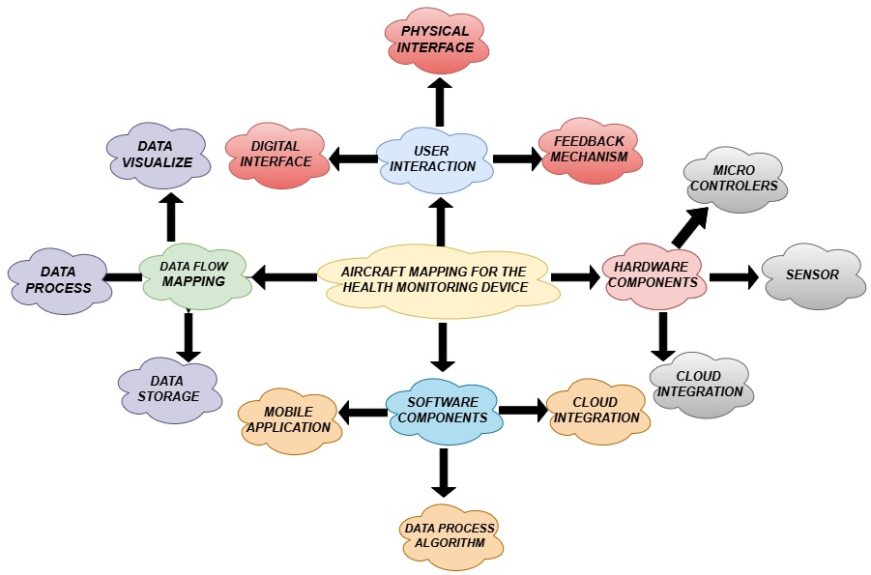
HEALTH DATA TRACKING
SECURITY & PRIVACY
HEALTH INSIGHTS, ANALYTICS
ALERT & NOTIFICATION
PERSONALIZED GOAL SETTINGS

Slide 22
WEEK 8
ACTIVITY PERSONAS &
OIOR TABLE

Slide 23
PERSONAS
PERSONA1
NAME: SHARAH
AGE: 30
LOCATION: TRICHY
OCCUPATION: IT EMPLOYEE
CHARACTERISTIC::
Focusing on cardiovascular health and stress management
Aims to find balance between her work,family responsibilities and personal health

Slide 24

OIOR TABLE
OBJECTIVE
INEERANCE
OPPORTUNITIES
RECOMMENDATIONS
Provide real-time,accurate monitoring of key health metrices(heart rate,blood pressure,sleep etc
Data overload:Users are overwhelmed by too much raw data and lack proper interpretation
Focus on actionable unsights rather than raw metrices to make data move meaningful
Use machine learning to provide users with smart,personalized health recommendations
Empower users with actionable health for preventive care and improved well -being
Inconsistent Accuracy some devices provide inaccurate or inconsistent readings,leading to distrust
Regularly update algorithm and provide calibration options to improve measurement
Invest in high quality sensors and calibration to improve trust and reliability of datra

Slide 25
OIOR TABLE
OBJECTIVE
INEERANCE
OPPORTUNITIES
RECOMMENDATIONS
Seamlessly integrate with user devices (smart phone,watches) to provide holistic view of health
Poor Integration:Difficulty syncing across multiple platform(Apple,Android,fitness App
Bulid robust API’s that ensure compatibility with multiple and health eco sysytem
Develop software that easily integrates with the widest range of platform
Deliver user friendly experience with easy to underst and metrices and minimal device
Low engagement or retention due to a lack of personalized insights and motivation
Use energy efficient hardware and software strategies to ensure long-lasting Battery
Implement better energy management techniques

